Slide 1

“Website Digg” Project
Soraia Felício
Analysis of Social Networks and Information
Professor: Carlos Soares

Slide 2
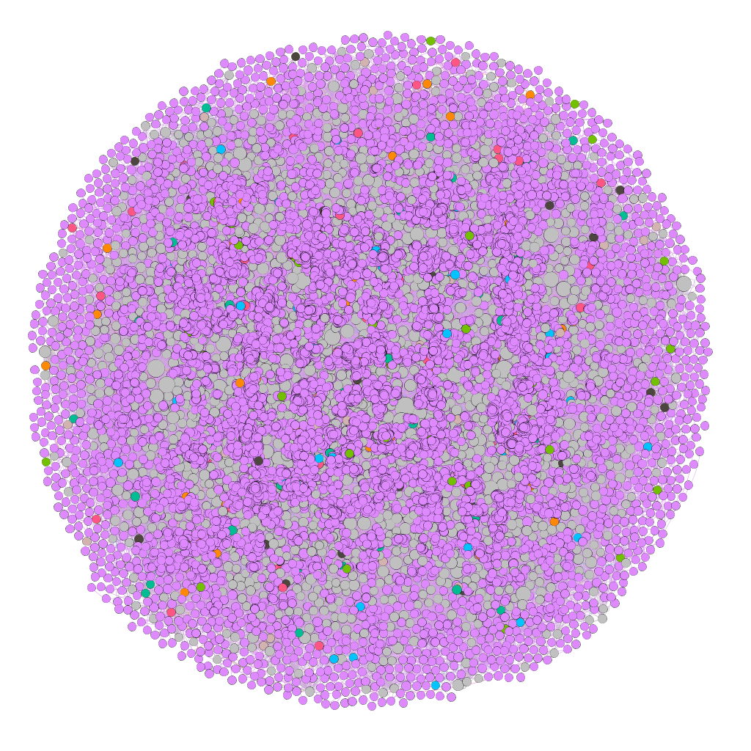
Context of the Project
Digg is a news aggregator that includes linking or sharing stories around a particular topic.
Data analysed in this Project is about communication: each node in the network is a user of the website, and each directed edge denotes that a user replied to another user.

Slide 3
Problem definition
In a more general context, how to evaluate in a network "who-talks-to-whom" the groups that are formed in a certain period of time and what conclusions we can obtain with these analyzes, if we disconsider the context.
This analysis was performed in the part of the social network Digg that has only one user action (which each user responded to the other users), in a given time interval.

Slide 4
Question research
Is it possible to find that seed user when we disconsider the context?
How to rate the most popular user on a network “who-talks-to-whom"?
Can we predict some synchronism of behavior in this network from the perspective only in the action of responding to the other user without considering the context?

Slide 5
Informations of the Digg network
Type Information | Digg network
Repository | Konect - Koblenz network collection. Has three categories of the Digg: communication, rating and social.
Format | Directed
Nodes | 30,398
87,627 | 87,627
Category | Communication
Tools | Gephi and Jupyter

Slide 6
Analysis Data and Results for the Project
Statistics of the Gephi in relation to nodes | Used to... | Result | Meanings for the project
Clustering coefficient: | probability to form triangles. | 0.008 in relation to average | There is the possibility that at least one set of users are friends.
Modularity class | it divide the nodes in group or class | 0.014 Modularity Coefficient 377 communities | Regarding the small world and the Watts-Strogatz model, the large amount of communication reveals that although a significant number of users on this network are not neighbors, they can communicate in a few steps until reaching the desired user.

Slide 7
Analysis Data and Results for the Project
Statistics of the Gephi in relation to nodes | Used to... | Result | Meanings for the project
Strongly Connected ID | strong and weak ties | 23,652 strong connections and 373 weak connections | This result reveals that network users are strongly connected and the few weak ties that exist allow the formation of local bridges. What confirms the small world model, through a few users it is possible to reach the most distant user.

Slide 8
Analysis Data and Results for the Project
Statistics of the Gephi in relation to nodes | Used to... | Result | Meanings for the project
In-degree | popularity of the nodes (in-degree and out-degree) | 73.23% of the nodes in-degree less or equal than 2 | It is necessary to evaluate these users more deeply to know what type of influence they are exercising in the entire network, for this it is necessary to correlate with the topics they are interacting with.

Slide 9
Analysis Data and Results for the Project
Filter of the the Gephi in relation to edges | Used to... | Result | Meanings for the project
Mutual edges | To evaluate the edges of both senses. To evaluate the positive and negative relationship | 154 nodes and 184 edges | This number of nodes and edges are considered a positive relationship, ie, there is an exchange of messages that suggests an interaction and a relationship. This amount also reveals that the number of interactions is low in relation to the total number of users on the network.

Slide 10
Homophily
Statistics Informations of the Koblenz | Values | Meanings for the project
Assortativity | 0.0046449 | Low ability to associate with other users. Suggesting that there are few similarities within the network.
Reciprocity | 1.55% | That indicates little interaction.

Slide 11
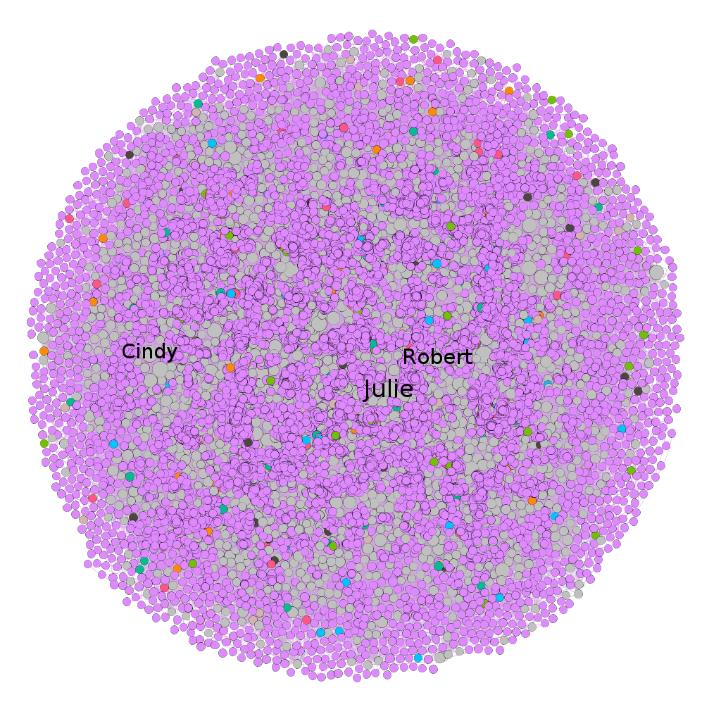
Rich-get-Richer
This network has some user more popularies, e.g., Julie, and Robert and Cindy. This situation is observed by neighbors quantity or by degree of these users.

Slide 12
Some test with particular user
To answer the research questions, some tests were done on a specific user. Following are more tests with three users who are related between them, through their replies in the Digg.

Slide 13
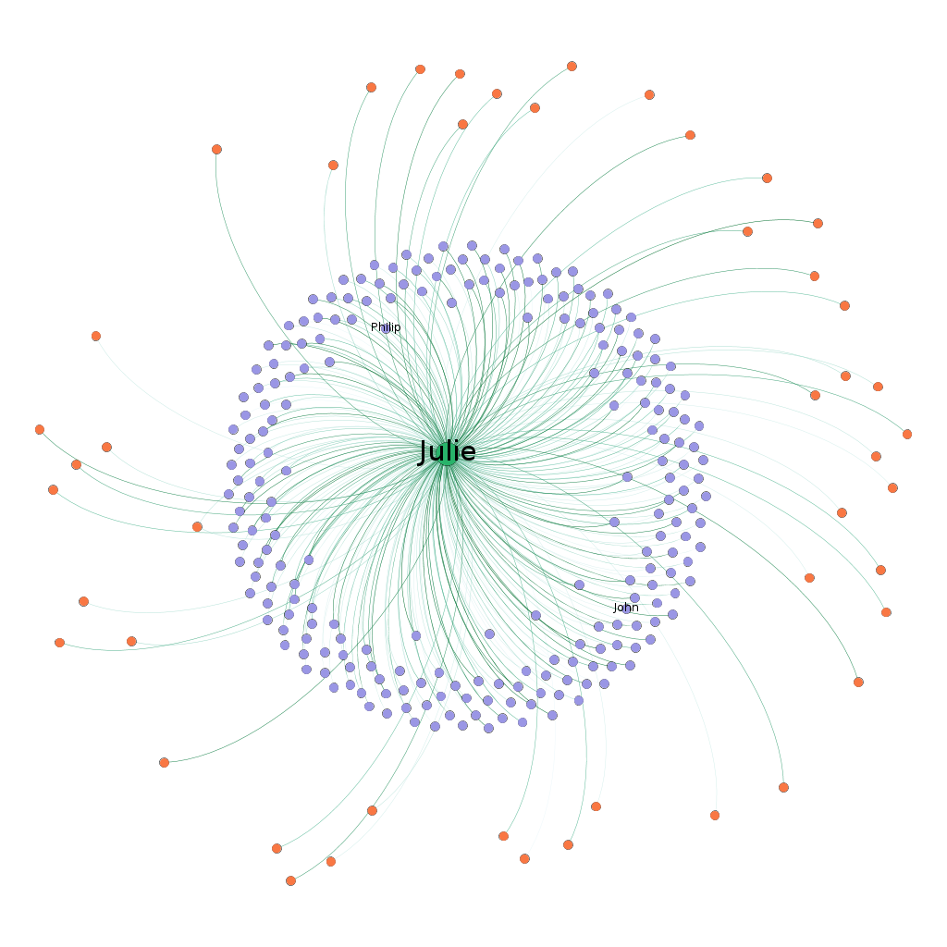
Cascading Behaviour
This user receives many messages suggesting that his interests arouse interest in other users. Somehow, his behavior can influence others.

Slide 14
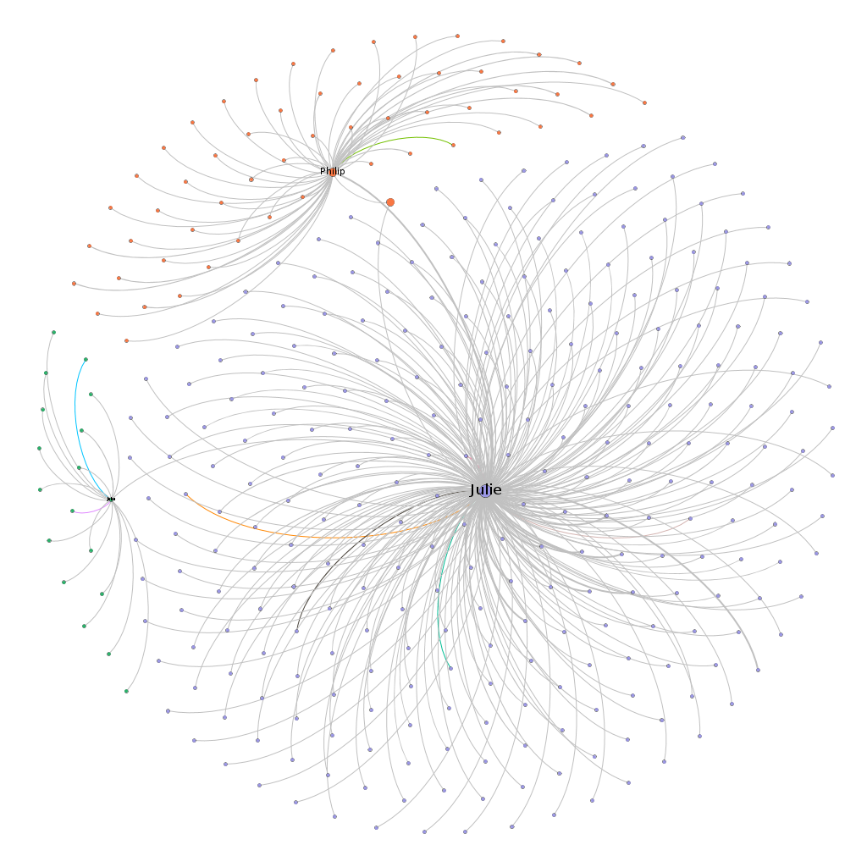
Small-World
This is proven when choosing other users close to him who form a local bridge in relation to the communities they form. Suggesting that the behavior of the previously chosen user may influence other nodes and communities.
This is related to the concepts of homophily, behavior cascade and epidemic model.

Slide 15
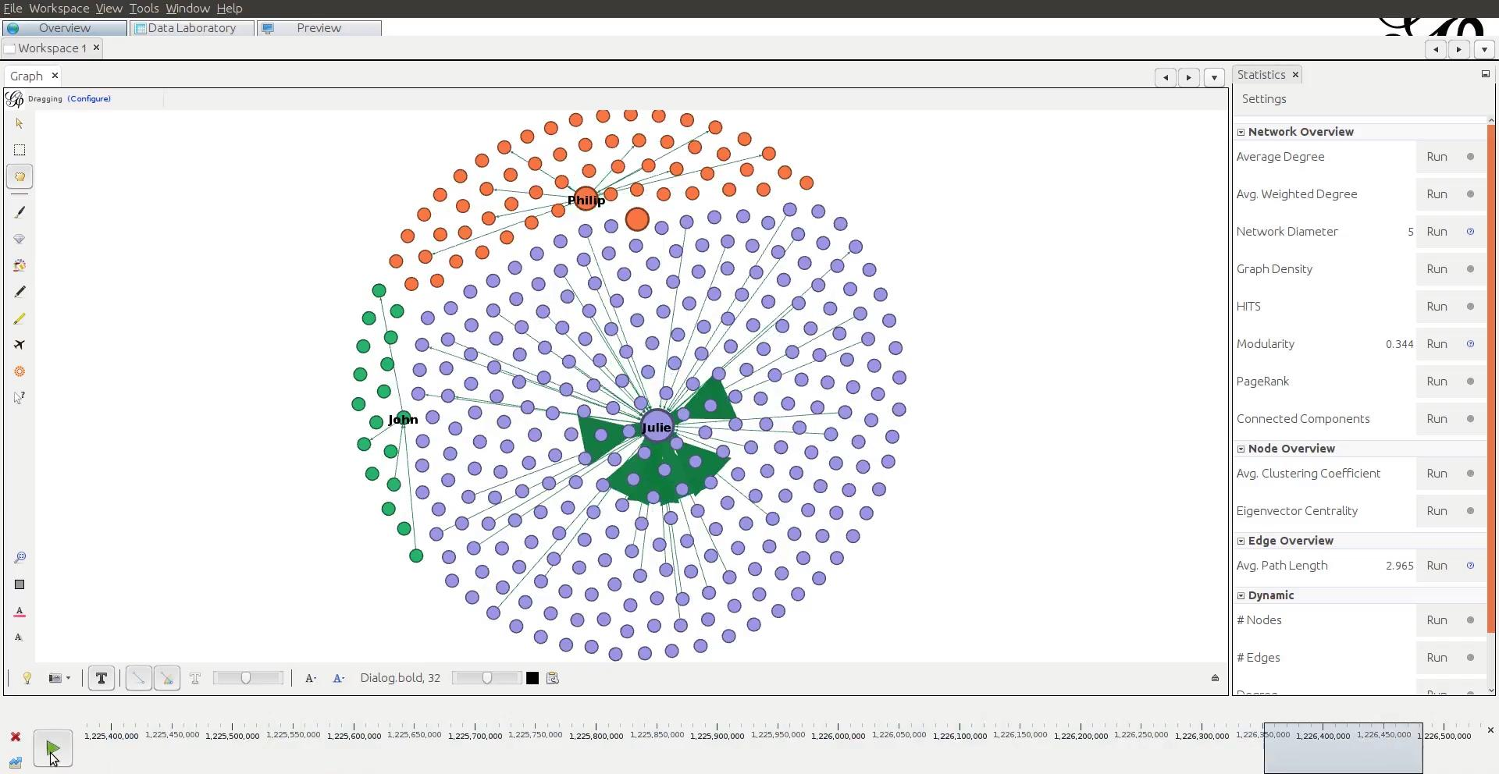
Epidemic model

Slide 16
Discussion
These analyzes reveal some clues about the research questions raised and previously and about the network in general:
1) The network does not have much interaction, although it is strongly connected, but this is justified because it is a news classification network as main focus and not interaction between users. This is perceived by the large amount of communication that involves the network as a whole (rôl), but with few communications carried out in both directions (positive relationship).
2) There are a few users who stand out in relation to the number of responses they have.
3) We consider seed users, the users have high degrees, ie, a lot of popularity.
4) The most popular user suggests that there is a synchronism and influence in relation to other users. As it is a small world it can spread its influence and impact the social network as a whole(rôl). Digg could consider in its functionalities topics that these users show more interest or the functionalities of following them, as it exists in other social networks.

Slide 17
References
Data source: http://konect.uni-koblenz.de/networks/munmun_digg_reply
Easley, D, and Kleinberg, J. Networks, Crowds, and Markets: Reasoning about a Highly Connected World. Cambridge University Press, 2010.

Slide 18

Thanks!

